Slide 1


Slide 2
XChange App
The interface was designed by using Fluid UI for touchscreen mobile phones.
A wide group of users can benefit from this application , including tourists,businessmen and stock traders.
With the help of this application , users can check EUR,USD,TRY and GBP exchange rates based on RON.

Slide 3
XChange App
The application does not require any username or password to access.
Exchange rates can be easily seen with the help of easy to use interface.
The application is trustful as it uses up-to-date values.And requires internet connection at least once to update values.

Slide 4
XChange App
The date is shown above the exchange rates , in the same page.
Names of the developers can be found by tapping “About Us” button.
The architecture off the application looks as follows:

Slide 5
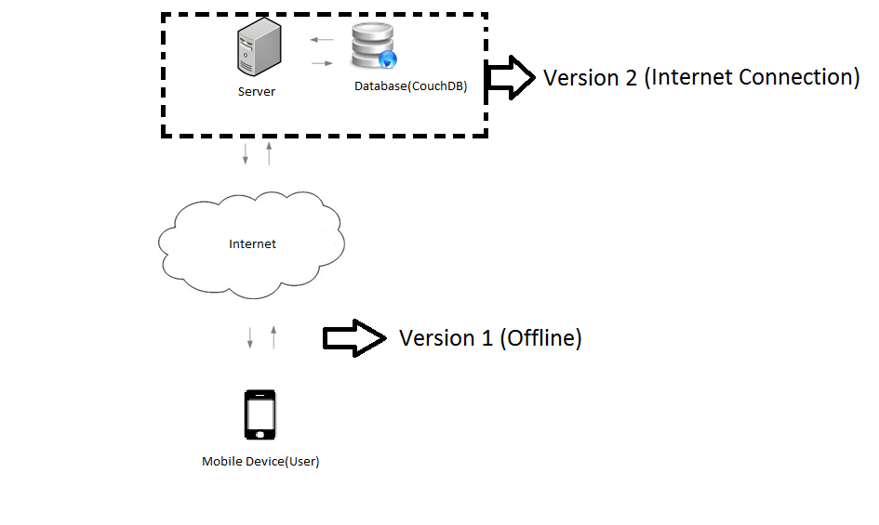

Slide 6
Xchange App
The application consists of 3 pages: Splash Screen , About Us and Exchange Rates.
The interface of the application looks as follows :

Slide 7
